Slide 1
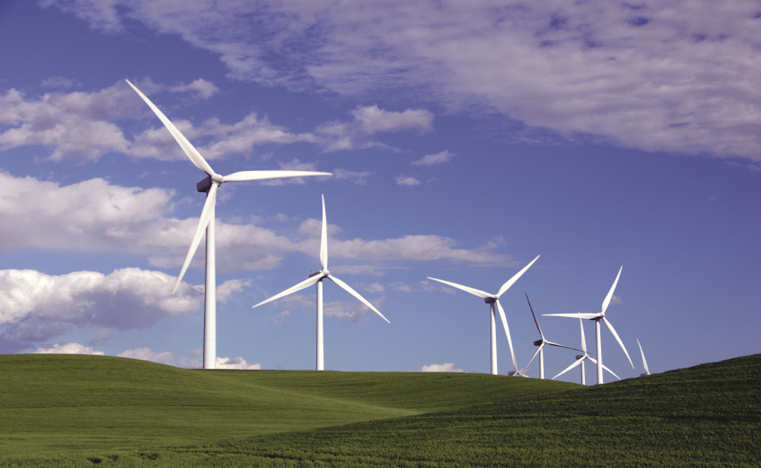
Unit-3
WIND ENERGY

Slide 2
UNIT III – WIND ENERGY
Wind energy - Energy chains - Application - Historical background.
Merits and limitations - Nature of wind - Planetary and local day / night winds
Wind energy quantum - Wind power density - Power calculations -Power in wind turbine –
Efficiency - Kinetic energy - Torque thrust calculations - Velocity at different heights.
Site selection - Favourable wind speed range - Wind energy conversion system - Energy pattern factor

Slide 3
Wind energy
Wind energy is the manifestation of solar energy
Wind is air in motion
Energy in the wind is converted into rotary mechanical energy by the wind-turbine
Unit rating of wind turbine generators covers a wide range from 0.5kW to 14MW The broad classification is as follows:
Very small 0.5kW to 1kW
Small 1 to 15
Medium 15 to 200
Large 250 to 1000
Very large 1000kW to 6000kW

Slide 4
Wind energy chains
Wind energy
Mechanical energy at wind turbine shaft
Electrical energy at generator
Electrical energy utilization
Wind energy
Mechanical energy at wind turbine shaft
Mechanical energy utilization
Energy chains of wind energy are:

Slide 5
Applications
Estimated that 2 % of all solar radiation falling on the face of the earth is converted to kinetic energy in the atmosphere and that 30 % of this K.E occurs in the lowest 1000m of elevation.
Harnessed –satisfies several energy demand of a country.
The worldwide installed capacity of wind power reached 283 GW by the end of 2012. China (75,564 MW), US (60,007 MW), Germany (31,332 MW) and Spain (22,796 MW) are ahead of
India in fifth position.
Pumping water,
Irrigation,
Grinding mills,
Saw mills,
Electricity

Slide 6
History of Wind Energy
5000 BC
Sailboats used on the Nile indicate the power of wind
500-900 AD
First windmills developed in Persia
1300 AD
First horizontal-axis
windmills in Europe
1850s
Daniel Halladay and
John Burnham build
Halladay Windmill;
start US Wind
Engine Company
Late 1880s
Thomas O. Perry
conducted 5,000
wind experiments;
starts Aermotor Company
1888
Charles F. Brush
used windmill to generate electricity
in Cleveland, OH
Early 1900s
Windmills in CA
pumped saltwater
to evaporate ponds
1941
In VT, Grandpa’s
Knob turbine
supplies power to
town during WWII
1979
First wind turbine
rated over 1 MW
began operating
1985
CA wind capacity
exceeded 1,000 MW
1993
US WindPower developed
first commercial variable-speed wind turbine
2004
Electricity from
wind generation
costs 3 to 4.5 cents per kWh
2011
Wind power provided
over 12% of renewable
energy used in US
Notes:
5000 BC - The history of wind energy is certainly long, beginning thousands of years ago. It is estimated that as early as 5000 B.C. sail boats were in use on the Nile as boatmen realized the power of the wind.
500-900 AD - The first windmills were developed in Persia for pumping water and grinding grain.
About 1300 - The first horizontal-axis windmills appeared in Western Europe.
1850s - Daniel Halladay and John Burnham worked to build and sell the Halladay Windmill, which was designed for the American West. It had an open tower design and thin wooden blades. They also started the U.S. Wind Engine Company.
Late 1880s - Thomas O. Perry conducted over 5,000 wind experiments trying to build a better windmill. He invented the mathematical windmill, which used gears to reduce the rotational speed of the blades. This design had greater lifting power, smoother pumping action, and could operate in lighter winds. Perry started the Aermotor Company with LaVerne Noyes.
The development of steel blades made windmills more efficient. Six million windmills sprang up across America as settlers moved west. Homesteaders purchased windmills from catalogs, traveling salesman, or they built their own. Mills were used to pump water, shell corn, saw wood, and mill grain.
1888 - Charles F. Brush used the first large windmill to generate electricity in Cleveland, Ohio. Windmills that produce electricity started to be called "wind turbines." In later years, General Electric acquired Brush's company, Brush Electric Co.
1893 - In Chicago, Illinois, the World's Columbian Exposition (aka the Chicago World Fair) highlighted 15 windmill companies who showcased their goods.
Early 1900s - Windmills in California pumped saltwater to evaporate ponds to produce salt for consumption.
1941 - On a hilltop in Rutland, Vermont, "Grandpa's Knob" wind turbine supplied power to the local community for several months during World War II. It had 53-meter blades and was the Smith-Putnam wind turbine.
1979 - The first wind turbine rated over 1 megawatt began operating. The cost of electricity from wind generation was about 40 cents per kilowatt-hour.
1985 - Many wind turbines were installed in California in the early 1980s to help meet growing electricity needs and take advantage of government incentives. By 1985, California wind capacity exceeded 1,000 megawatts, enough power to supply 250,000 homes. These wind turbines were inefficient compared to today’s turbines.
1993 - U.S. WindPower developed one of the first commercially available variable-speed wind turbines, the 33M-VS. The final prototype tests were completed in 1992. The $20 million project was funded mostly by U.S. Windpower, but also involved Electric Power Research Institute (EPRI), Pacific Gas & Electric, and Niagara Mohawk Power Company.
2004 - Electricity from wind generation cost 3 - 4.5 cents per kilowatt-hour.
2011 - Wind power provided 12.8 percent of the renewable energy consumed in the U.S. In the U.S., wind power produced enough electricity on average to power the equivalent of over 10 million homes.

Slide 7
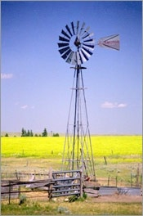
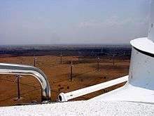
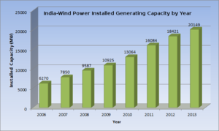
Wind energy in India
As of 31 March 2014 the installed capacity of wind power in India was 21136.3 MW, mainly spread across
Tamil Nadu (7253 MW),Gujarat (3,093 MW),
Maharashtra (2976 MW), Karnataka(2113 MW),
Rajasthan (2355 MW), Madhya Pradesh (386 MW),
Andhra Pradesh (435 MW),
Kerala (35.1 MW), Orissa (2MW),West Bengal (1.1 MW) and other states (3.20 MW).

Slide 8
Power in the wind
Three factors determine the output from a wind energy converter
The wind speed
The cross section area of wind swept by rotor
The overall conversion efficiency of the rotor, transmission system and generator or pump.

Slide 9
ADVANTAGES
Wind energy is friendly to the surrounding environment, as no fossil fuels are burnt.
Wind turbines take up less space than the average power station..
Newer technologies are making the extraction of wind energy much more efficient. The wind is free, and we are able to cash in on this free source of energy.
Wind turbines are a great resource to generate energy in remote locations, such as mountain communities and remote countryside. Wind turbines can be a range of different sizes in order to support varying population levels.
Another advantage of wind energy is that when combined with solar electricity, this energy source is great for developed and developing countries to provide a steady, reliable supply of electricity.

Slide 10
Disadvantages
The main disadvantage regarding wind power is down to the winds unreliability factor.
Wind turbines generally produce allot less electricity than the average fossil fuelled power station, requiring multiple wind turbines to be built in order to make an impact.
Wind turbine construction can be very expensive and costly to surrounding wildlife during the build process.
The noise pollution from commercial wind turbines is sometimes similar to a small jet engine. This is fine if you live miles away, where you will hardly notice the noise, but what if you live within a few hundred meters of a turbine? This is a major disadvantage.
Protests and/or petitions usually confront any proposed wind farm development. People feel the countryside should be left in tact for everyone to enjoy it’s beauty.

Slide 11
Nature of wind and origin of wind
Winds are a natural phenomena in the atmosphere and has two different origins.
Planetary winds: Caused by daily rotation of earth around its polar axis and unequal temperature between polar regions and equatorial regions.
Local winds: Caused by unequal heating and cooling of ground surfaces and ocean/lake surfaces during day and night

Slide 12
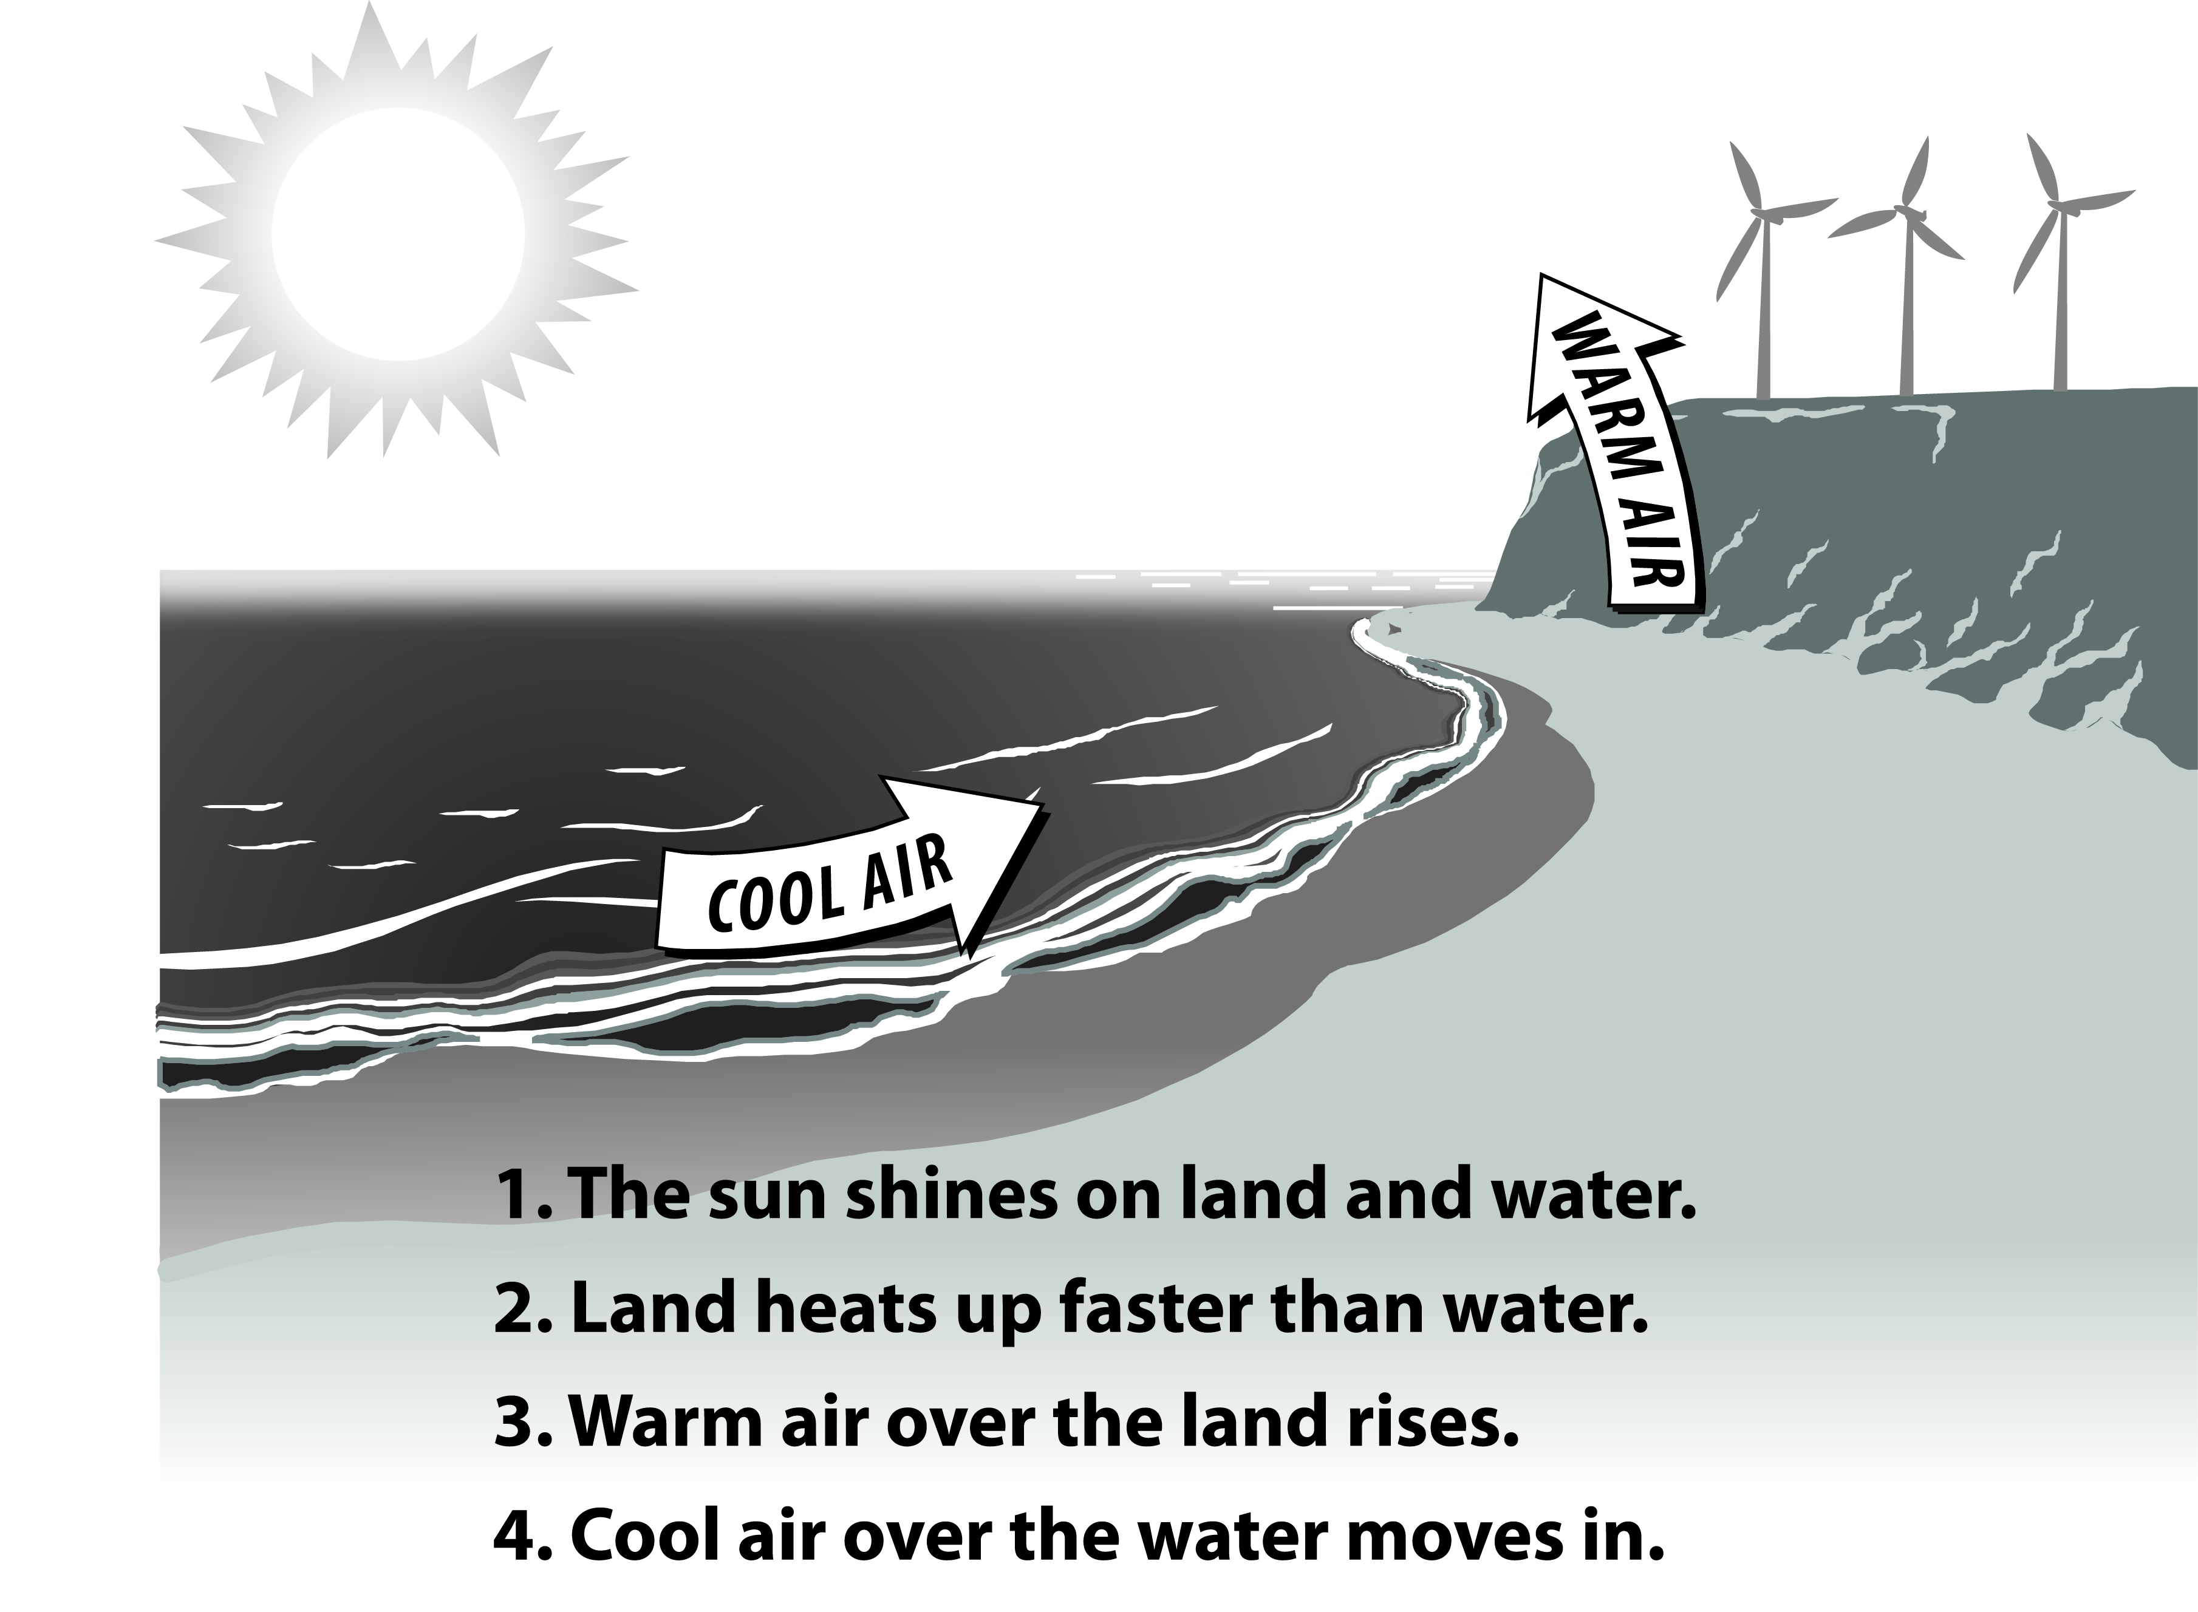
What Makes Wind
Notes:
Heat from the sun causes convection in the atmosphere, meaning the heated air rises. These currents create zones of high and low air pressure within the atmosphere. As the heated air rises, it creates a low pressure zone near the ground. Air from surrounding cooler areas rushes in to balance the pressure. These horizontal pressure differences account for the ambient wind and more intense storm wind.

Slide 13
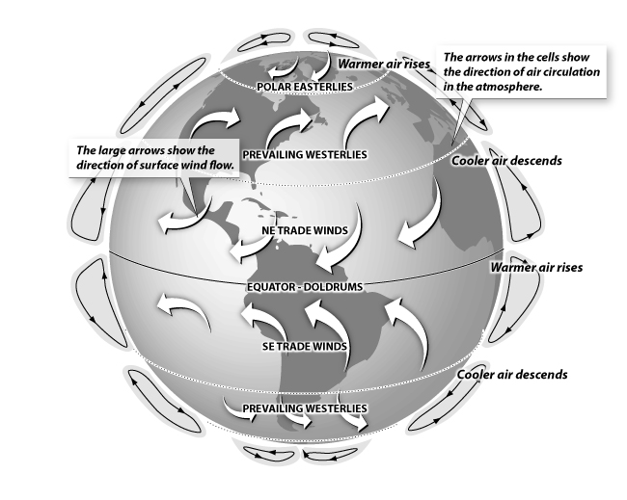
Global Wind Patterns
Notes:
Prevailing winds are caused by the temperature differences between the Earth’s poles and its equatorial regions, as well as Earth’s rotation. The Earth’s atmosphere has several very large and steady prevailing patterns, such as the polar easterlies and the northeast trade winds. Winds are named based on the direction they originate from. In North America, one of the prevailing dominant wind paths track in an arc from the prairies to the Great Lakes and the eastern seaboard – this wind travels in a westerly direction.
Wind energy is also affected by other factors. Air currents move faster and more consistently at higher altitudes–think of the blustery conditions at the tops of tall buildings or on mountain tops. Similarly, wind tends to gather energy when it moves unimpeded over longer distances, which is why very flat regions, such as the prairies, tend to be highly exposed to intense winds.

Slide 14
Why Wind Energy?
Clean, zero emissions
- NO_{x}, SO₂, CO, CO₂
- Air quality, water quality
- Climate change
Reduce fossil fuel dependence
- Energy independence
- Domestic energy—national security
Renewable
- No fuel-price volatility
Notes:
Wind energy is a renewable source of energy, and is considered renewable because it is derived from the sun and is capable of being replenished on a reasonable time scale.
Although wind is a zero emissions electrical generation option, there are emissions in the construction and development of wind projects—concrete, transportation of components, etc.

Slide 15
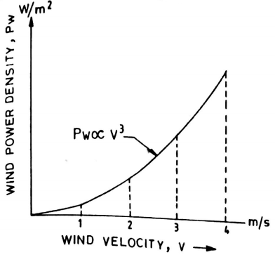
Power velocity characteristics of wind

Slide 16
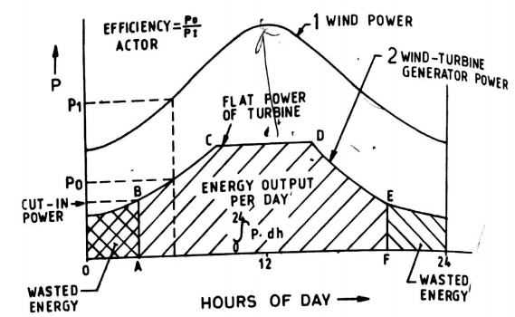
Power curves

Slide 17
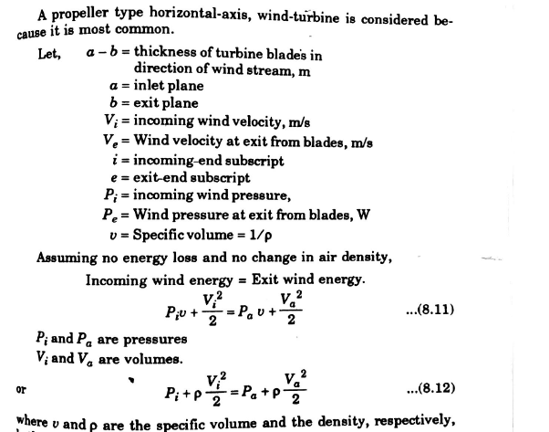
Power of wind turbine for a incoming wind velocity Vi

Slide 18
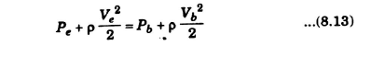
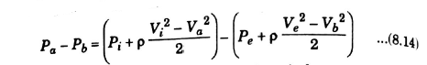
For the exit end

Slide 19
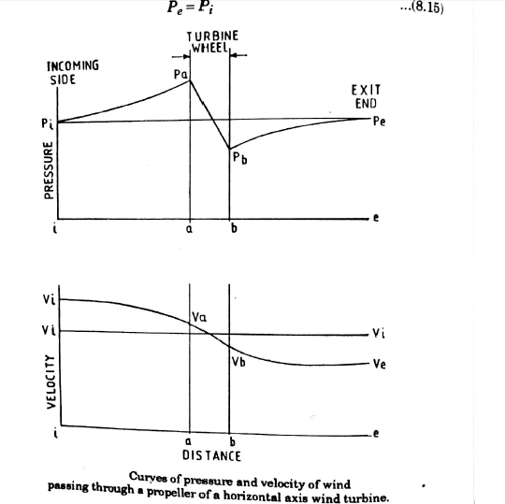

Slide 20
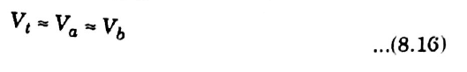
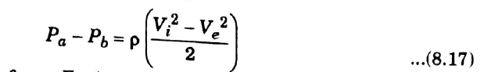
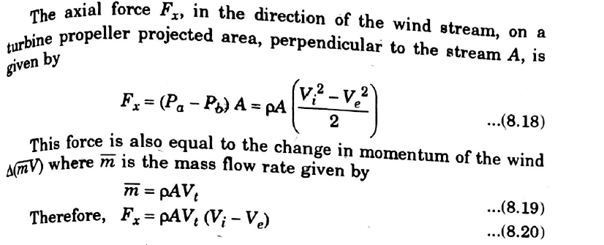

Slide 21
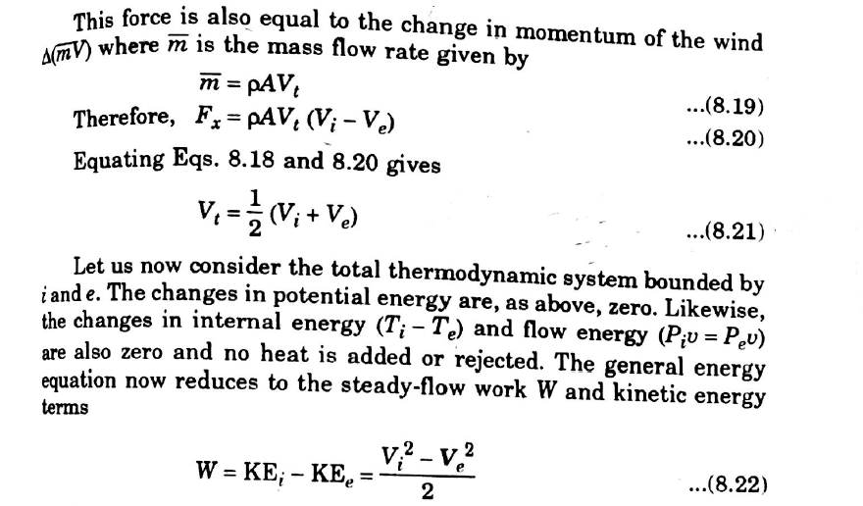

Slide 22
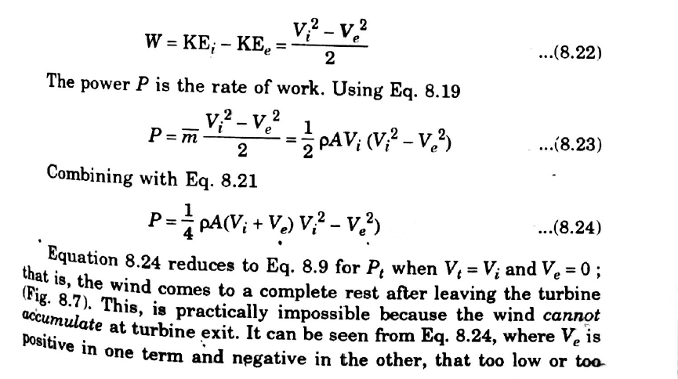

Slide 23
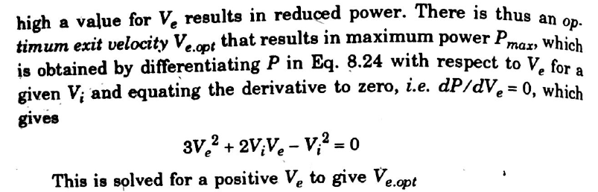
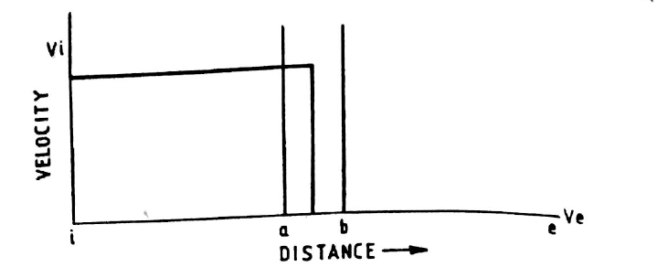
Total conversion of internal wind energy to work

Slide 24
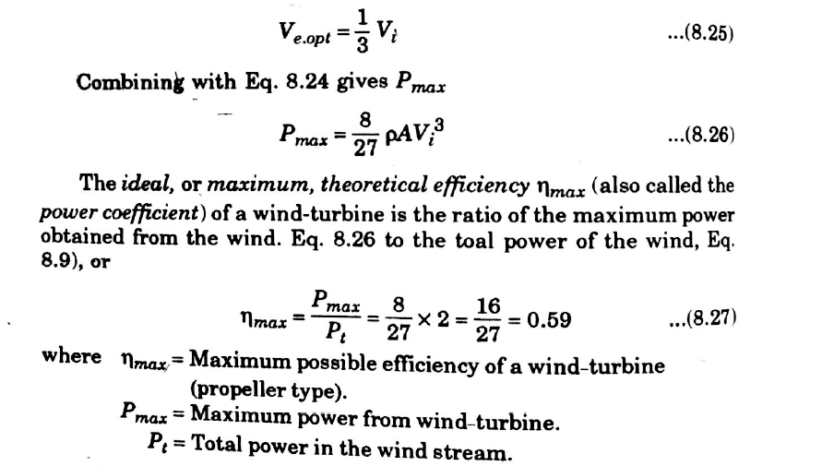

Slide 25
Power coefficient
Ideal or maximum theoretical efficiency also called as power coefficient of a wind turbine
Power coefficient Cp =
Power output from wind turbine / Power available in wind
The factor Cp (0.593) is known as Betz coefficient

Slide 26
Site selection consideration
Annual average wind speed-fundamental requirements
Availability of anemometry data
Availability of wind Vt curve at the proposed site
Wind structure at the proposed site.
Altitude of the proposed site
Terrain and its aerodynamic
Local ecology
Distance to road and railways
Nearness of site to local centre/users
Nature of ground
Favourable land cost
Other conditions

Slide 27
High Annual average wind speed-fundamental requirements.
Doubling V,increases - Pw by a factor of 8
Strategy
Survey of historical wind data
Contour maps
Potential sites visited
Best site are instrumented
Choose the optimal site

Slide 28
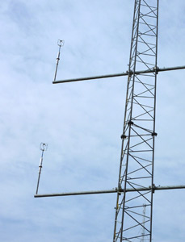
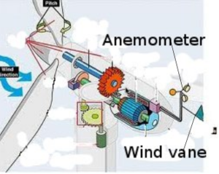
Anemometer-Availability of anemometry data

Slide 29
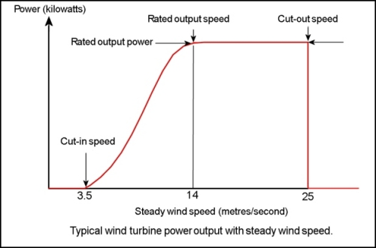

Slide 30
Components of WECS

Slide 31
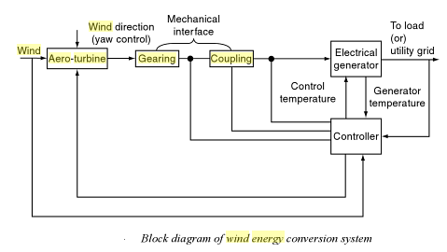
Basic Components

Slide 32
Aero turbines convert energy in moving air to rotary mechanical energy
Pitch control
Yaw control
In large machines, a servo mechanism operated by a wind-direction sensor controls the yaw motor.
A Mechanical interface consisting of a step up gear and a suitable coupling transmits the rotary mechanical energy to an electrical generator.
Output of the generator is connected to the load or power grid.
Yaw control
Yaw Fixed
Yaw Active
fluid

Slide 33
Controller:
Sense wind speed, wind direction, shaft speeds, torques, output power and generator temperature.
Generates appropriate control signal.
Rotor:
Rotors are mainly two types:
Horizontal axis rotor
Vertical axis rotor-Advantage: operate in all wind directions and need no yaw adjustment.

Slide 34
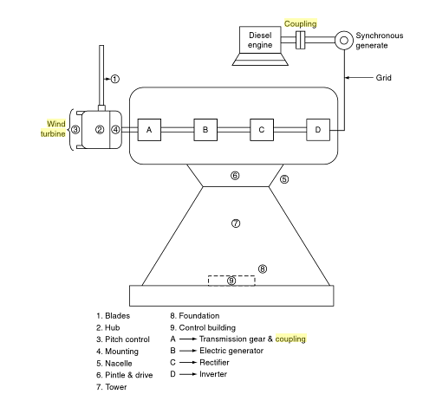

Slide 35
Windmill head: supports the rotor, housing the rotor bearings.
Transmissions: Rate of rotation of large wind turbine generators 40-50 rpm
Optimum generator output requires-1800 rpm-it is necessary to increase greatly the low rotor rate of turning.
Fixed ratio gears(top mounted equipment), belts and chains, singly or in combination or hydraulic systems involving fluid pumps and motors

Slide 36
Generators : Either constant or variable speed generators
Variable generators – Expensive
Constant speed generators are used
Generator
Synchronous
Permanent magnet

Slide 37
Controls: Modern large wind turbine generator requires a versatile and reliable control system to perform the following functions:
Orientation of rotor into the wind
Start up and cut-in of the equipment, shutdown and
cut-out-very high wind speed.
Power control of the rotor by varying the pitch of the blades.
Generator output monitoring
Protection for the generator
Auxiliary /emergency power
Maintenance mode.

Slide 38
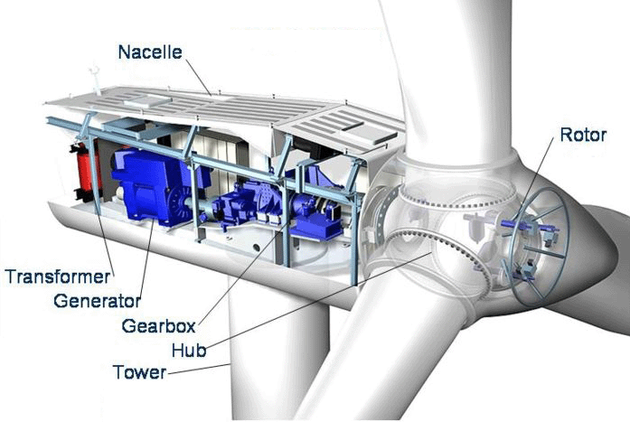

Slide 39
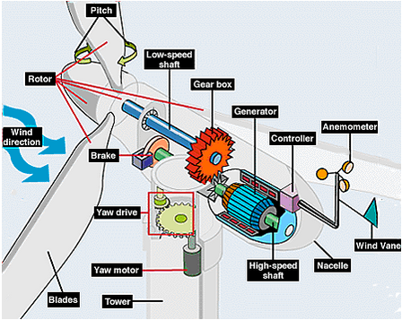

Slide 40
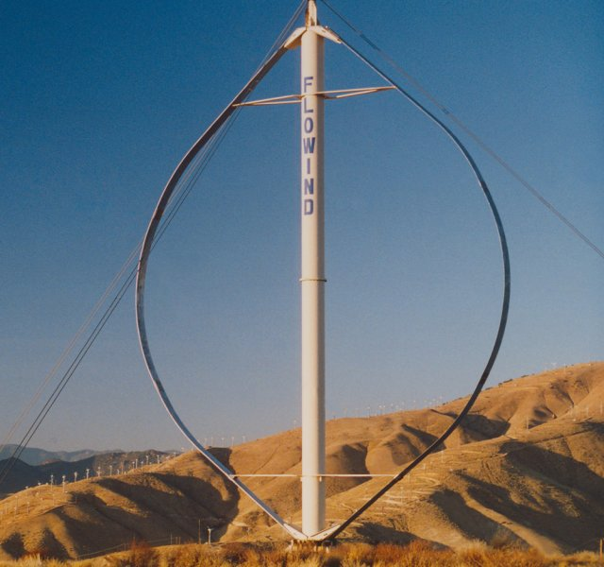
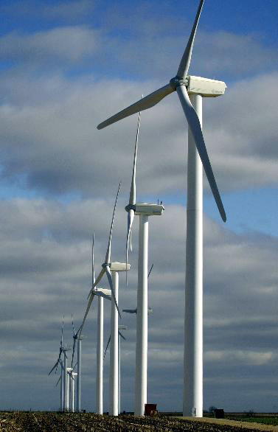
Modern Wind Turbines
Turbines can be categorized into two classes based on the orientation of the rotor.
Notes:
Turbines can spin on a vertical axis (left photo) or horizontal axis (right photo).

Slide 41
Vertical-Axis Turbines
Advantages
Disadvantages
Omni-directional
- accepts wind from any direction
Components can be mounted at ground level
- ease of service
- lighter weight towers
Can theoretically use less materials to capture the same amount of wind
Rotors generally near ground where wind is poorer
Centrifugal force stresses blades
Poor self-starting capabilities
Requires support at top of turbine rotor
Requires entire rotor to be removed to replace bearings
Overall poor performance and reliability
Notes:
Vertical-axis machines have blades that go from top to bottom and the most common type, the Darrieus wind turbine, looks like a giant, two-bladed eggbeater. This type of vertical wind turbine typically stands 100 feet tall and 50 feet wide. New design concepts come to market on a regular basis. Vertical-axis wind turbines make up only a very small percent of the wind turbines used today.

Slide 42
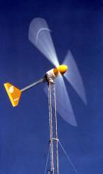
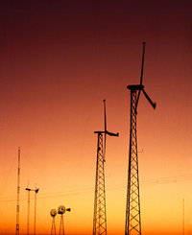
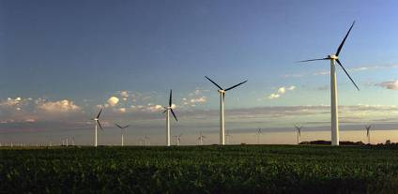
Horizontal-Axis Wind Turbines
Small (<10 kW)
Homes
Farms
Remote Applications
(e.g., water pumping,
Telecom sites, ice making)
Intermediate(10-250 kW)
Village Power
Hybrid Systems
Distributed Power
Large (250 kW-2+ MW)
Central Station Wind Farms
Distributed Power
Schools
Notes:
Most wind turbines being used today are the horizontal-axis type. Horizontal-axis wind turbines have blades like airplane propellers. Wind turbines stand tall and wide to capture more wind—providing more “swept area” where the blades make contact with the wind.
A one megawatt (1 MW) wind turbine will typically generate enough power for about 300 homes. This depends on the type of device and where it is located.
Most large turbines that you see today are rated at 1.5 megawatts. This means at peak output (high winds) it will be producing about 1.5 megawatts of electricity.

Slide 43
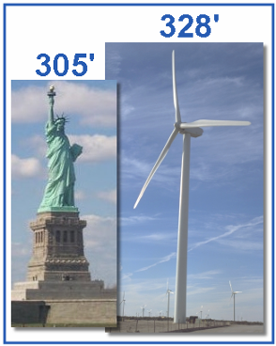
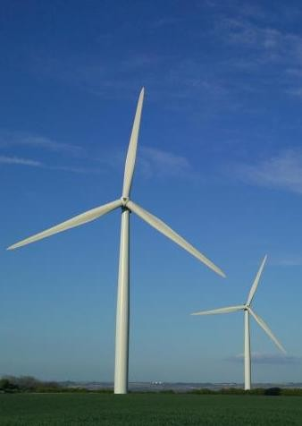
Large Wind Turbines
Common Utility-Scale Turbines
328’ base to blade
Each blade is 112’
200 tons total
Foundation 20’ deep
Rated at 1.5-2 megawatts
Supply about 500 homes
Notes:
A typical U.S. large-scale horizontal wind turbine stands 80-100 meters (263-328 feet) tall and has three blades that are each 34-55 meters (112-181 feet) long. They weigh 200-400 tons and produce enough electricity to power 500 homes.
The largest turbine currently in production is the Enercon E-126 which as a capacity of 7.58 MW.
The E-126 tower stands 135 meters (443 feet) tall and has a blade diameter of 127 meters (417 feet).
A number of companies are developing 10 MW turbines mostly for use in offshore applications.

Slide 44
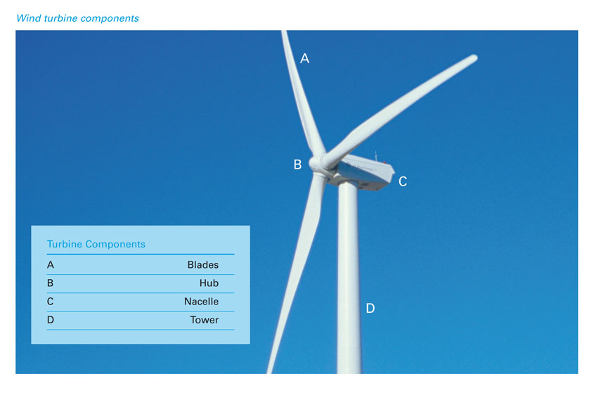
Wind Turbine Components
Notes:
Regardless of the size, all turbines have the same parts.
Blades on modern turbines are similar to airplane blades, lifted by the wind.
The hub connects the blades to the shaft and generator.
The nacelle houses the generator.
The tower holds the turbine high above anything that might cause turbulence in the air such as trees and buildings. Towers can be lattice or monopole for large turbines. Most modern day turbines have monopole towers made of steel.

Slide 45
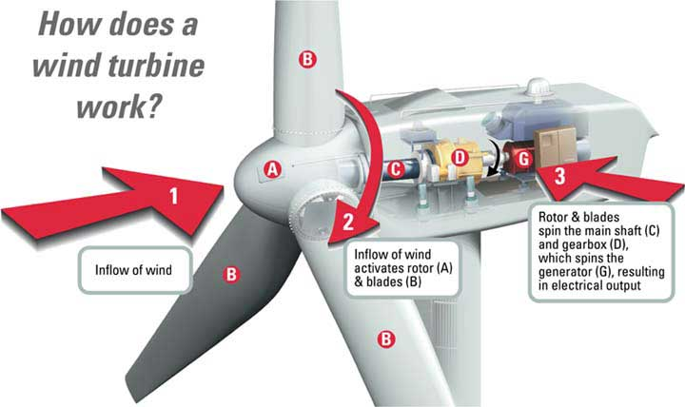
How a Wind Turbine Operates
Notes:
Comparing large turbines to small turbines:
Large turbine blades can be actively pitched by hydraulics and spin at 12-20 RPM—much slower than a small wind turbine.
Large turbines have a driveshaft attached to the gearbox—that step up the rotations from 12-20 RPM to 1600 RPM for the generator.
The generator is what creates electricity, turning coils of wires inside magnets.
Small wind turbines use vanes (typically) to track the wind while large turbines use an anemometer and hydraulics to face the turbine into the wind.
Large turbines are highly computerized and automated, sensing weather conditions and turning themselves off if there is a problem.
Large turbines are often connected by computers to a central control location.

Slide 46
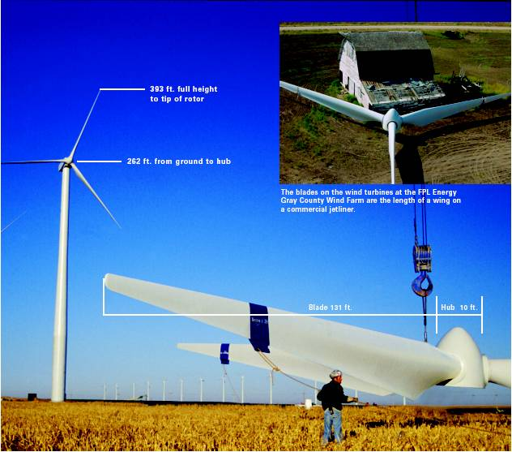
Installation of Wind Turbines
Notes:
Large scale turbines are brought to the construction site in multiple pieces and assembled on site. Specialized trucks transport the components to these often remote locations because, even though the turbine is disassembled, individual pieces are still very large. Towers are transported in 65- to 100-foot long sections. Blades are transported one or two blades per truck.
Prior to erecting the tower, concrete foundations are poured to hold the turbine securely in place.
Once the components arrive at the site, large cranes are used to assemble the pieces, stacking the tower and nacelle first. The blades are attached to the hub on the ground and lifted on to the front of the nacelle.
Note the size comparison to the barn in the upper right hand corner.

Slide 47
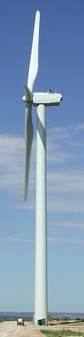
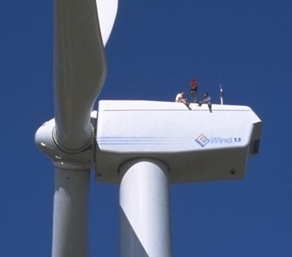
Wind Turbine Perspective
Workers
Blade
112’ long
Nacelle
56 tons
Tower
3 sections
Notes:
Large turbines have ladders or lift systems inside the tower so technicians can access the nacelle and perform maintenance. When work must be performed on the outside of the nacelle, safety harnesses are worn.

Slide 48
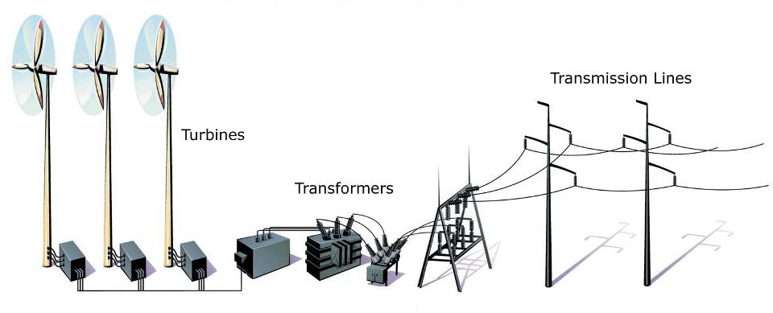
Wind Farms
Notes:
Wind farms are like power plants, with a number of turbines wired together before going to the transformer.
The transformer steps up the voltage before the electricity goes out on transmission lines and the electricity grid.
Some wind farms are very large. The largest wind farm in the U.S. is currently the Alta Wind Energy Center in California with 390 turbines and a 1,020 MW capacity. Large farms such as this can provide as much electricity as a traditional power plant when the wind is blowing.

Slide 49
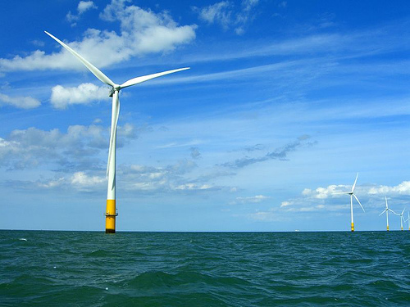
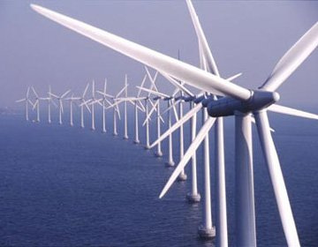
Offshore Wind Farms
Notes:
Many developers would like to move wind farms offshore because wind is faster, smoother and can be close to major population centers on the coast. The Bureau of Ocean Energy Management at the Department of the Interior has been granted authority to regulate offshore wind development in federal waters.
There are currently no offshore wind farms in the U.S. Offshore wind development has been met with opposition in early projects such as the Cape Wind Energy Project. Other offshore construction is also expected to begin on the coast of Virginia.

Slide 50
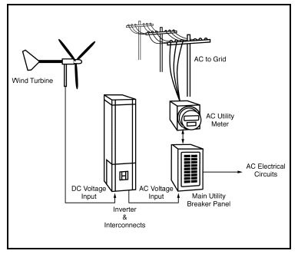
Residential Wind Systems and Net Metering
Notes:
"Net metering" is a method of metering the energy consumed and produced at a home or business that has its own renewable energy generator, such as a wind turbine. With net metering capability, excess electricity produced by the wind turbine will spin the electricity meter backwards. This provides the customer with a credit to pull from when more electricity is needed. The customer is sometimes provided with full retail value for all the electricity produced. Not all utilities allow for net metering.
Under existing federal law (PURPA, Section 210), utility customers can use the electricity they generate with a wind turbine to supply their own lights and appliances, offsetting electricity they would otherwise have to purchase from the utility at the retail price. But if the customer produces any excess electricity (beyond what is needed to meet the customer’s own needs) and net metering is not allowed, the utility purchases that excess electricity at the wholesale or “avoided cost” price, which is much lower than the retail price. The excess energy is metered using an additional meter that must be installed at the customer’s expense.
Net metering simplifies this arrangement by allowing the customer to use any excess electricity to offset electricity needs used at other times during the billing period. In other words, the customer is billed only for the net energy consumed during the billing period.
These small installations are often referred to as distributed power. Distributed power is generating capacity that is not located near a baseload power plant.

Slide 51
Potential Impacts and Issues
Property Values
Noise
Visual Impact
Land Use
Wildlife Impact
Properly siting a wind turbine can mitigate many of these issues.
Notes:
Proper siting of wind turbines is the best way to address many of the potential issues that arise. Siting turbines away from populated areas can address issues of noise and visual impact while siting turbines away from preservation areas and wetlands with a focus on siting in areas which already have seen development (ranching, farming, resource extraction, etc) can address land use issues. In fact, wind farms have been seen in many places as an additional use of farming and ranching land since those activities can still take place on land below the turbines.
An in-depth study was completed by the Renewable Energy Policy Project in 2003 on the effect of wind development on local property values. There was no evidence of reduction of value of 25,000 property transactions.

Slide 52
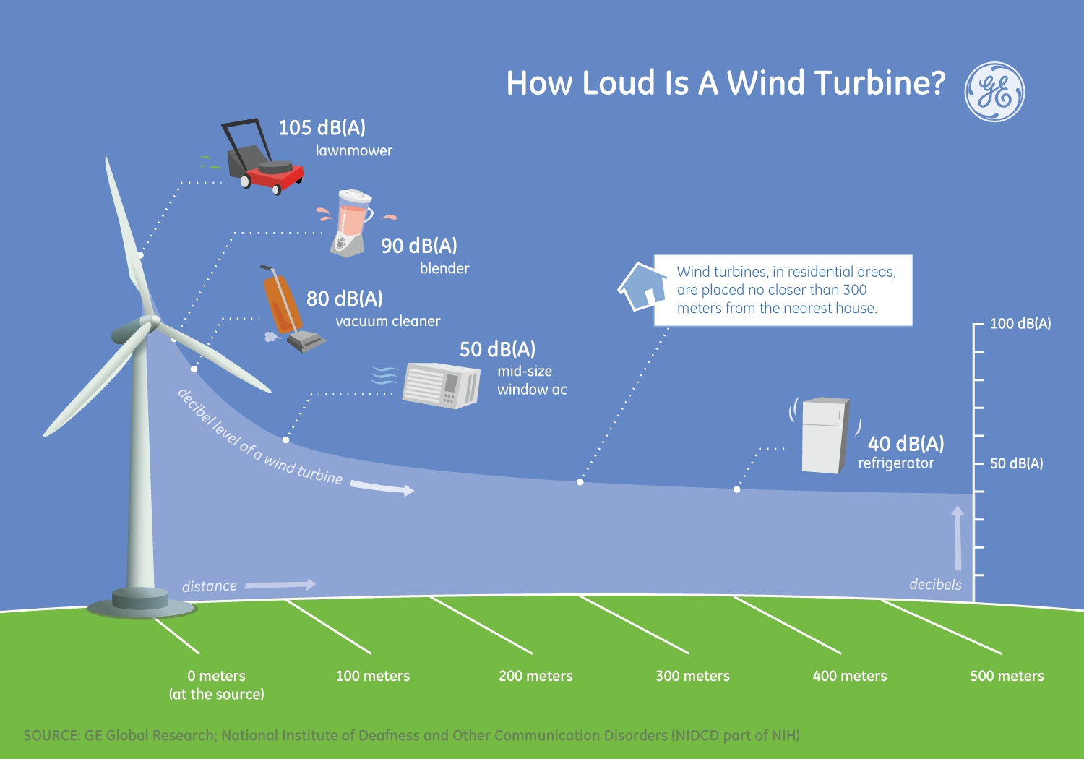
Impacts of Wind Power: Noise
Notes:
In the past, turbines have been perceived as noisy machines. While modern day turbines do produce some noise, when sited at a proper distance from homes and businesses, the noise level is less than many household appliances.

